Slide 1
Recitation 8: E20 Pipeline
CSUY 2214

Slide 2
What are Labels?

Slide 3
memory addresses
(Courtesy of Rishyak Panchal, 2024)

Slide 4
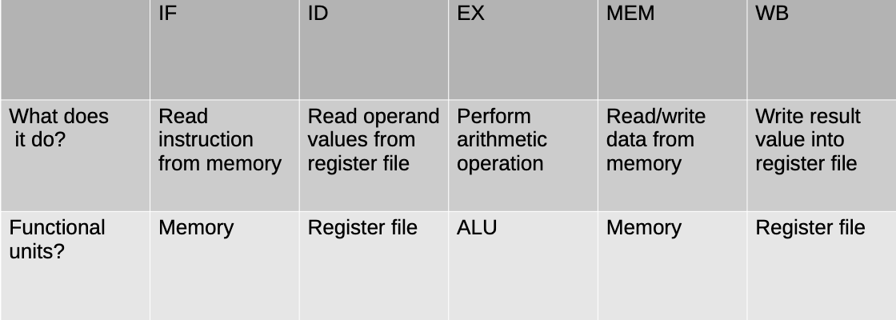
E20 Multicycle Review

Slide 5
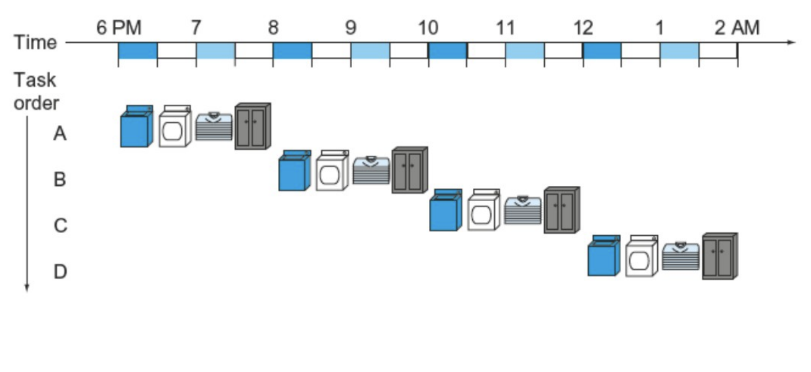
Why We Do Pipeline

Slide 6
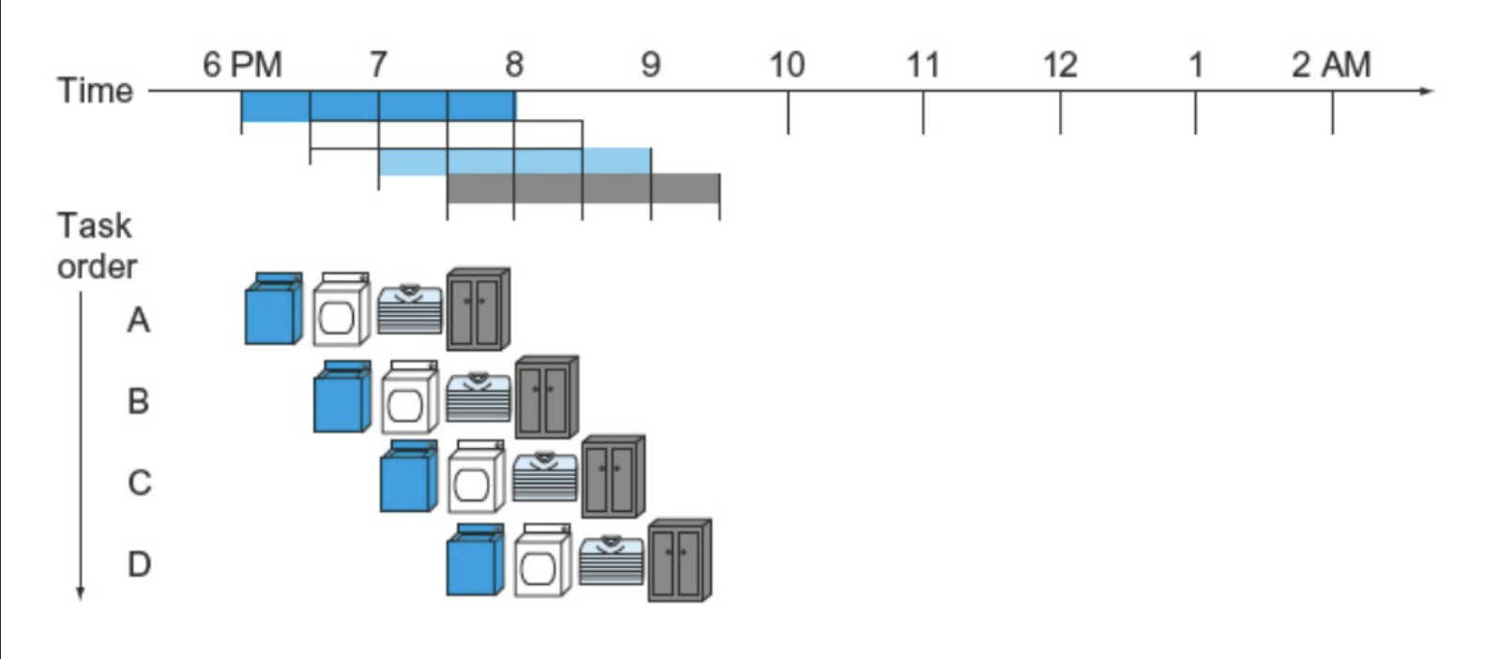
Why We Do Pipeline

Slide 7
Example E20 program
addi $1, $0, 1
addi $1, $1, 1
Do you see a problem?
Time | IF | ID | EXEC | MEM | WB
1
2
3
4
5
6
7
(Courtesy of Rishyak Panchal, 2024)

Slide 8
Example E20 program
addi $1, $0, 1
addi $1, $1, 1
Time | IF | ID | EXEC | MEM | WB
1 | addi $1, $0, 1
2
3
4
5
6
7
(Courtesy of Rishyak Panchal, 2024)

Slide 9
Example E20 program
addi $1, $0, 1
addi $1, $1, 1
Time | IF | ID | EXEC | MEM | WB
1 | addi $1, $0, 1
2 | addi $1, $1, 1 | addi $1, $0, 1
3
4
5
6
7
(Courtesy of Rishyak Panchal, 2024)

Slide 10
Example E20 program
addi $1, $0, 1
addi $1, $1, 1
Time | IF | ID | EXEC | MEM | WB
1 | addi $1, $0, 1
2 | addi $1, $1, 1 | addi $1, $0, 1
3 |  | addi $1, $1, 1 | addi $1, $0, 1
4
5
6
7
(Courtesy of Rishyak Panchal, 2024)

Slide 11
Example E20 program
addi $1, $0, 1
addi $1, $1, 1
Reading a value from $1 before it is written!
Time | IF | ID | EXEC | MEM | WB
1 | addi $1, $0, 1
2 | addi $1, $1, 1 | addi $1, $0, 1
3 |  | addi $1, $1, 1 | addi $1, $0, 1
4
5
6
7
(Courtesy of Rishyak Panchal, 2024)

Slide 12
Data Conflicts
2 or more instructions share a resource (Registers or Memory Cells)
Write-after-Read
Write-after-Write
Only an issue for reordering
Data Hazards
Data conflict you must fix
Read-after-Write

Slide 13
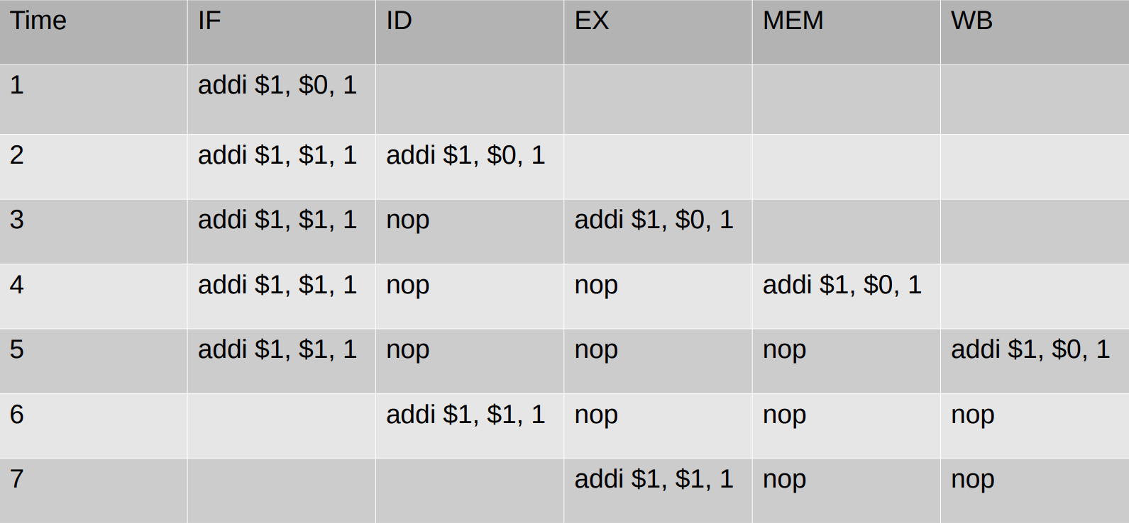
Stalling

Slide 14
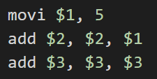
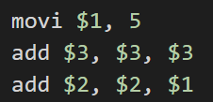
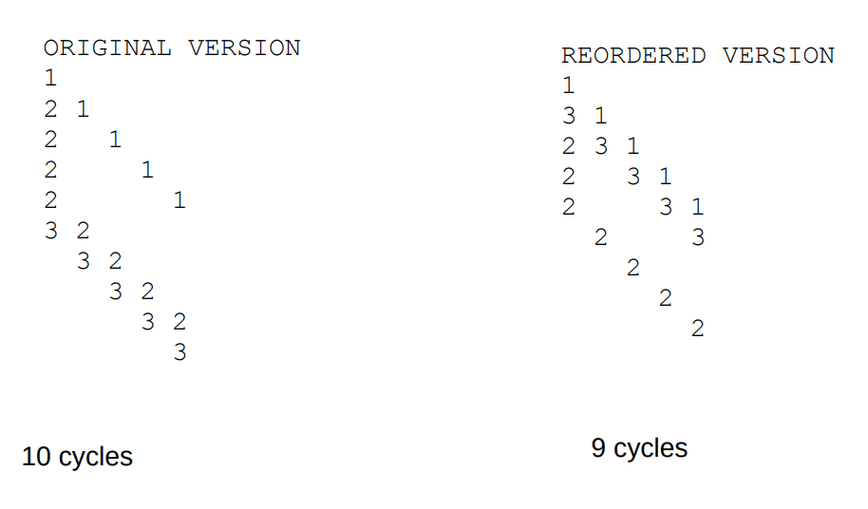
Reordering
Allows us to increase efficiency
Sometimes allows us to avoid stalling
Need to be aware of Hazards AND Conflicts
NEVER CHANGE THE RELATIVE ORDER OF TWO INSTRUCTIONS THAT HAVE A CONFLICT

Slide 15
Control Hazards
Basically a “Read-after-Write” hazard but involves the ‘pc’
Solutions:
Stalling
Branch Prediction (‘jeq’ only)
Branch Prediction: We guess the outcome of ‘jeq’ and hope we’re right.
Branch usually taken
Branch usually not taken
Dynamic Branch Prediction

Slide 16
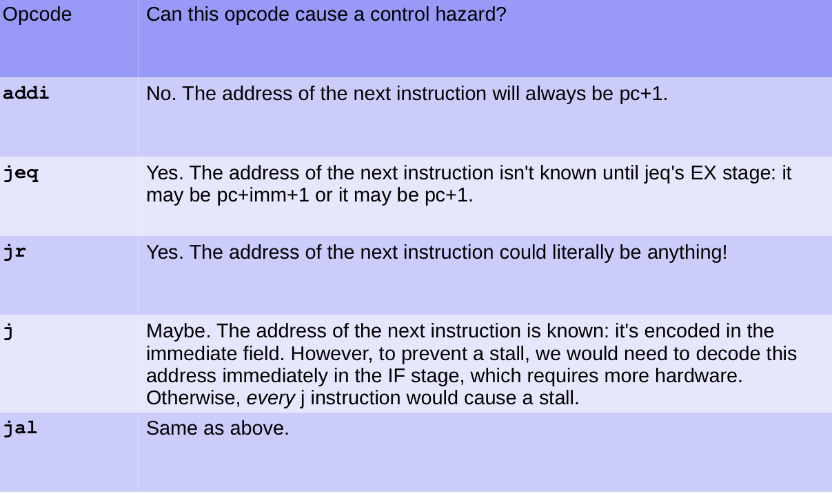

Slide 17
“Examples”

Slide 18
2) Identify all data conflicts/hazards and control hazards for each code fragment. Specify the instructions (by line number) and the shared resource(s):
b) 1. movi $1, 5
2. addi $1, $1, 20
c) 1. sw $1, 0($4)
2. movi $5, 40
3. sw $2, 0($4)

Slide 19
e) 1. movi $1, 50
2. jr $1

Slide 20
3) Give all valid reorderings of the code fragments from question 2
b) 1. movi $1, 5
2. addi $1, $1, 20
c) 1. sw $1, 0($4)
2. movi $5, 40
3. sw $2, 0($4)

Slide 21
3) Give all valid reorderings of the code fragments from question 2
e) 1. movi $1, 50
2. jr $1

Slide 22
CPI & Clock Frequency
CPI: “Cycles per Instruction”
Clock Frequency: “Cycles per Second” (i.e. Hz)
Hypothetical Computer (Example):
50% of instructions take 1 clock cycle
15% of instructions take 4 clock cycles
35% of instructions take 8 clock cycles
Average CPI = .5 (1 cycle) + .15 (4 cycles) + .35 (8 cycles) = 3.7 CPI

Slide 23
Further Details about
E20 Pipeline
(Created by former TA Rishyak Panchal and former NYU Professor Jeff Epstein
RIP to both)

Slide 24
Conflicts
movi $1, 1
add $2, $2, $1
lw $1, foo($0)
add $2, $2, $1
sw $1, foo($0)
lw $2, foo($0)
Conflicts occur when a pipelined instruction shares the use of a register or memory location with another concurrently in the pipeline.
Depending on the processor’s architecture, they can further cause data hazards (issues with the instruction pipeline that prevent the next instruction from executing in its dedicated clock cycle)
In E20, we are principally concerned with so-called read-after-write dependencies, wherein one instruction attempts to read data before that data has been written.
In each of the above three program fragments, the first instruction writes a value, and the second instruction reads the same value.
The bolded term identifies the conflicted resource.
Note that in the first two fragments, the conflicted resource is a register, while in the third fragment, the conflicted resource is a memory cell.

Slide 25
Conflicts
Other data conflicts:
Write-after-read conflict
addi $1, $2, 1
addi $2, $3, 1
This is a conflict, but is a concern only when instructions are potentially re-ordered.
Write-after-write conflict
addi $1, $2, 1
addi $1, $3, 1
This is a conflict, but is a concern only when instructions are potentially re-ordered.
Read-after-read non-conflict
addi $1, $2, 1
addi $3, $2, 1
This is not a conflict, and cannot cause a hazard.
Instructions may read the same value without conflicting.

Slide 26
Solution One: Stall the processor by inserting bubbles
addi $1, $0, 1
addi $1, $1, 1
$0 | $1 | $2 | $3 | $4 | $5 | $6 | $7
0 | 1 | 0 | 0 | 0 | 0 | 0 | 0
Time | IF | ID | EXEC | MEM | WB
1 | addi $1, $0, 1
2 | addi $1, $1, 1 | addi $1, $0, 1
3 | addi $1, $1, 1 | nop | addi $1, $0, 1
4 | addi $1, $1, 1 | nop | nop | addi $1, $0, 1
5 | addi $1, $1, 1 | nop | nop | nop | addi $1, $0, 1
6 |  | addi $1, $1, 1 | nop | nop | nop
7 |  |  | addi $1, $1, 1 | nop | nop

Slide 27
Reordering Instructions
1. movi $1, 5
2. add $2, $2, $1
3. add $3, $3, $3
1. movi $1, 5
3. add $3, $3, $3
2. add $2, $2, $1
Sometimes we can avoid stalls by reordering instructions
Manually, by the programmer
Automatically, by the compiler
Automatically, by the processor (aka. out-of-order execution)
Consider the following program:
There is a conflict between the first two instructions that could cause a stall of 3 cycles, while instruction 1 finishes WB and instruction 2 enters ID.
Now consider this version:
The program produces identical results, but completes one cycle sooner.
Draw the cycle execution table to convince yourself of this fact.

Slide 28
1. movi $1, 5
2. add $2, $2, $1
3. add $3, $3, $3
1. movi $1, 5
3. add $3, $3, $3
2. add $2, $2, $1
1
2 | 1
2 |  | 1
2 |  |  | 1
2 |  |  |  | 1
3 | 2
 | 3 | 2
 |  | 3 | 2
 |  |  | 3 | 2
 |  |  |  | 3
1
3 | 1
2 | 3 | 1
2 |  | 3 | 1
2 |  |  | 3 | 1
 | 2 |  |  | 3
 |  | 2
 |  |  | 2
 |  |  |  | 2
10 Cycles
9 Cycles

Slide 29
Reordering is tricky
1. movi $1, 5
2. add $2, $2, $1
2. add $2, $2, $1
1. movi $1, 5
We must be careful that the reordered program produces the correct result
Consider the following:
There is a read-after-write hazard on $1, which could cause a stall.
So, let's reorder the code like this:
We no longer have a read-after-write hazard, and can therefore avoid a stall. BUT this reordering is an invalid transformation: it produces a different result than the original. A principal policy of reordering instructions is that the new version must produce identical results as the original.
To prevent an invalid transformation, we should abide by this rule:
Never change the relative order of two instructions that have a conflict,
including read-after-write, write-after-write, and write-after-read.
In this case, the read-after-write hazard prevents us from reordering them.

Slide 30
Solution Two: Forwarding (NOTE: We don’t really cover this in HW/Rec)
addi $1, $0, 1
addi $1, $1, 1
$0 | $1 | $2 | $3 | $4 | $5 | $6 | $7
0 | 2 | 0 | 0 | 0 | 0 | 0 | 0
Time | IF | ID | EXEC | MEM | WB
1 | addi $1, $0, 1
2 | addi $1, $1, 1 | addi $1, $0, 1
3 |  | addi $1, $1, 1 | addi $1, $0, 1
4 |  |  | addi $1, $1, 1 | addi $1, $0, 1
5 |  |  |  | addi $1, $1, 1 | addi $1, $0, 1
6 |  |  |  |  | addi $1, $1, 1
7

Slide 31
Control Hazards
movi $1, 0
jeq $1, $0, somewhere
add $2, $2, $2
somewhere:
add $3, $3, $3
Control Hazards occur when a pipelined instruction makes a wrong decision in branch prediction, causing some partially executed instructions to be discarded
Assume that we have a processor that always predicts branch-not-token, i.e. the processor will pipeline the instruction immediately subsequent to a conditional jump (aka. static branch prediction)
In the following program, the processor will pipeline add $2, $2, $2, even though that instruction will not be executed. Its partial execution must therefore be discarded.

Slide 32
Control Hazards
What specifically causes control hazards depends on the processor’s branch prediction logic. Sophisticated processors will use clever techniques to reduce wrong prediction and therefore reduce control hazards.
For example, consider a processor that predicts branches in a loop based on the decision taken in the previous iteration (aka. dynamic branch prediction).
Another way of thinking about control hazards:
A control hazard is a read-after-write data hazard, with the special property of occurring on the program counter, rather than on a regular register or memory address.

Slide 33
Branch Prediction and Speculative Execution
movi $1, 50
loop:
jeq $1, $0, done
addi $1, $1, -1
j loop
done:
halt
movi $1, 50
loop:
addi $1, $1, -1
slti $2, $1, 1
jeq $2, $0, loop
halt
Consider two programs:
What is the best branch prediction strategy to maximise correct predictions?

Slide 34
Branch Prediction and Speculative Execution
movi $1, 50
loop:
jeq $1, $0, done
addi $1, $1, -1
j loop
done:
halt
movi $1, 50
loop:
addi $1, $1, -1
slti $2, $1, 1
jeq $2, $0, loop
halt
No branch
No branch
No branch
. . .
Branch
halt
Branch
Branch
Branch
. . .
No branch
halt
Consider two programs:
Branch is usually NOT taken
Branch is usually taken

Slide 35
Branch Prediction and Speculative Execution
movi $1, 50
loop:
jeq $1, $0, done
addi $1, $1, -1
j loop
done:
halt
movi $1, 50
loop:
addi $1, $1, -1
slti $2, $1, 1
jeq $2, $0, loop
halt
Consider two programs:
Branch is usually NOT taken
Branch is usually taken
Let's predict branch if the instruction branched last time.
Let's predict predict no branch if the instruction didn't branch last time.
For loops, this will usually be right. This is an an example of dynamic branch prediction.
We maintain a special 1-bit register for each jeq instruction. Each time we execute the jeq, we store 1 if it branched (taken), 0 if it didn't (not taken). We use this value to predict branching or non-branching in the next iteration. This is called a One-Level Branch Predictor.

